Slide 1
American marriage compared to other countries
B8 Kai vogel

Slide 2
Main question
Do people in U.S. merry and divorce more easily than other country?

Slide 3
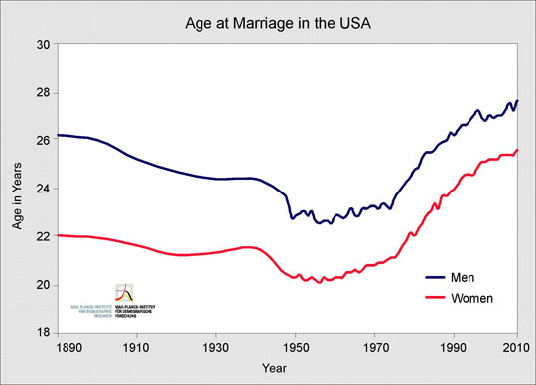
Facts about u.s. marriage
People are getting married later in life. The average age of those married for the first time is currently 28.5 for men and 26.4 for women (2012)
The marriage rate continues to decline in the United States since 1970s
Compared with Whites, African Americans are more likely to have children outside of marriage, are less likely to marry at all, and if they do marry, are more likely to ending in divorce.
Both men and women have higher life expectancies when married than those who are single or divorced

Slide 4
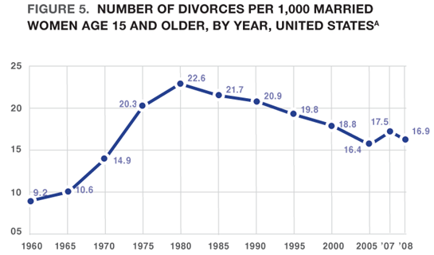
Facts about u.s. marriage
The American divorce rate is nearly twice what it was in 1960, but it has declined somewhat since 1980.
If you have decent education, decent income, merry after age of 25, and have child after marrying; chance of divorce will be very low.

Slide 5
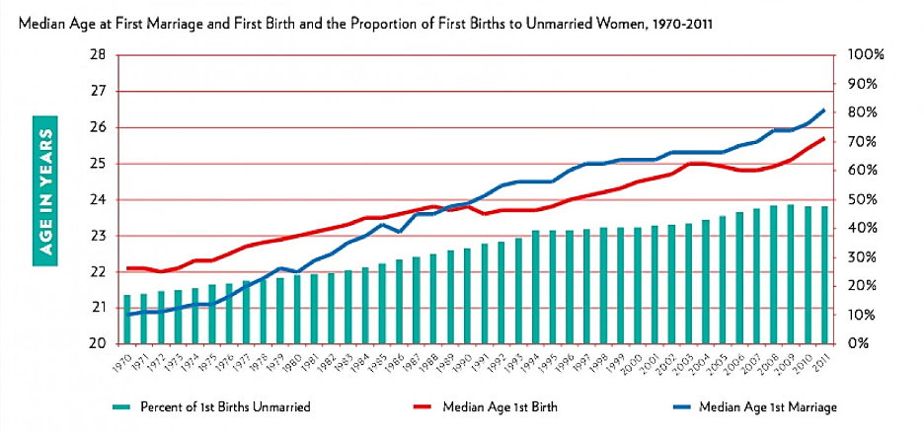
Interesting Fact about u.s. marriage
The average age for childbearing is now younger than the average age for marriage

Slide 6
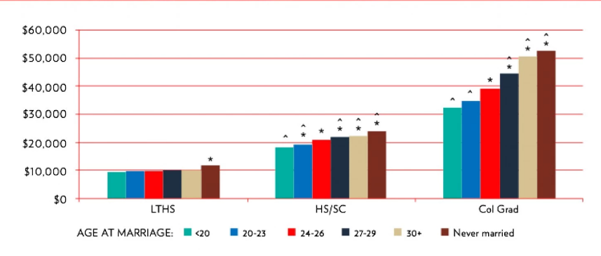
Interesting Fact about u.s. marriage
Women who wait until age 30 to marry make much more money

Slide 7
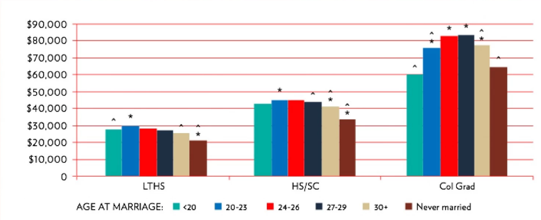
Interesting Fact about u.s. marriage
That's not true for men, however.

Slide 8
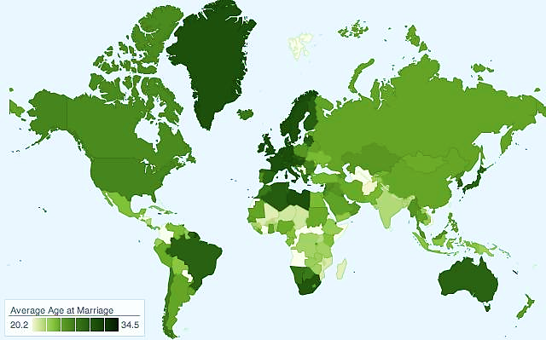
Average age at marriage in world
World average to get marry is 25.6 years.
Western Europe rank among the highest for average age at marriage at above 30 years. While countries like Afghanistan has one of the lowest at 20.2 years.
The gender age gap for marriage is wider in less developed countries: women get married 8.3 years earlier in Afghanistan to 1.8 years in France,

Slide 9
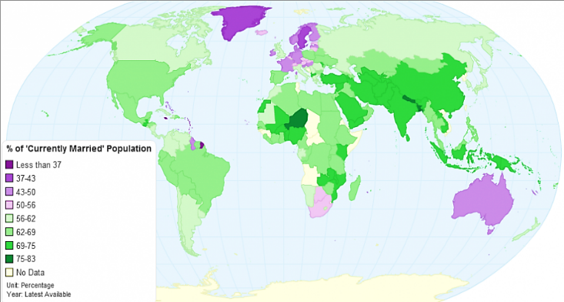
Percentage of currently married population in world
Country with more wealth has lower percentage of married population because simply wealthier country has more number of people that will not marry, and also the age of marrying is higher so the unmarried people will increase.
Not wealthy part of Asia has the highest percentage of married people because they marries faster than wealthy country, and lives longer compared to Africa.

Slide 10
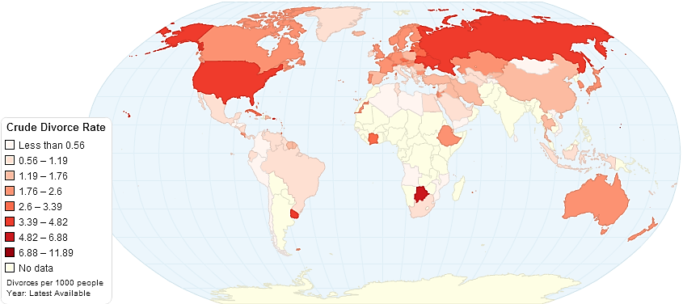
Crude divorce rate in world
Botswana 6.88 divorce per 1000
Russia 4.82 divorce per 1000
.
.
.
6. U.S. 3.80 divorce per 1000
.
.
.
Lowest in the data
Yemen and Mozambique
0.01 divorce per 1000
Yemen
Botswana
Mozambique

Slide 11
World Marriage Overview
In general the higher is per capita income, the older are people who get married at first time. In developed countries like Germany, France, Italy, Norway, Japan, and Australia the age at first marriage exceeds 30 years.
On the other hand in low income middle African countries the age at first marriage is between 17-20 years for females and 23-25 years for males.
Also low income countries will have wider age gap in marriage. This is because women does not have rights to choose their partner.

Slide 12
Conclusion
Compared to world, American people will get marry more easily and divorce more easily, but this is good thing because that means people who is going to marry will have more rights to marry and also divorce. But on the other hand it will make problems like complicated family relationship and higher rate of single mothers, which is rare for other countries.
My opinion is that U.S. differs from other high standard countries because U.S. has more variety of people and race, so the culture is mixed up and people actually marries with love, rather than family or parents’ decision.

Slide 13
references
Stanley, S. K. (Ed.). (2013, August 5). WHY MARRIAGE MATTERS Facts And Figures. Retrieved May 25,
2015, from For Your Marriage website: http://www.foryourmarriage.org/factsfigures/
Bhatt, N. (Ed.). (2012, November 22). At What Age Do People Get Married Around the World? Retrieved
May 25, 2015, from princeonomics website: http://priceonomics.com/
at-what-age-do-people-get-married-around-the-world/
Top 10 Countries with Highest Divorce Rate in 2014. (n.d.). Retrieved May 25, 2015, from topfor
website: http://top10for.com/top-10-countries-highest-divorce-rate-2014/
Metcalfe, J. (2013, October 22). These Countries Have the Oldest, and Youngest, First Marriages.
Retrieved May 25, 2015, from City lab website: http://www.citylab.com/politics/2013/10/
these-countries-have-oldest-and-youngest-first-marriages/7313/

